Slide 1
Backpropagation XOR

Slide 2
Setup
Two perceptrons in the hidden layer
One output perceptron
Two inputs
Sigmoid AF boii
Shuffleing of the array
Lenght of data array 1000
Maximum nr. epochs 10000

Slide 3
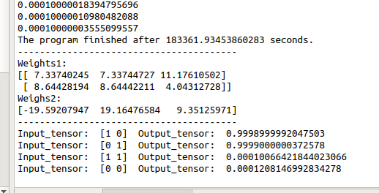
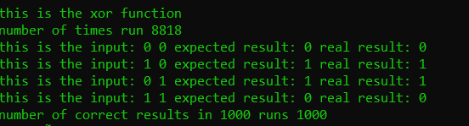
Results
With the sigmoid it would never reach exactly 1.
C++ code stopped after reaching an error of 0.000001.
Python stopped after reaching an error of 0.0001.

Slide 4
Conclusion
It was possible to teach a multilayer peceptron system to categorize the XOR-problem.
Due to the random generation of weights it will sometimes get stuck on a local minimum and therefore fail the training session.
Tests with different learning rates?

